Slide 1
Routing Security Status in GCC
Aftab Siddiqui
siddiqui@isoc.org
@aftabsiddiqui

Slide 2
Global Routing System Overview
(as of 25 September 2023)
74,590 networks known as Autonomous Systems are connected to the Internet, each using a unique Autonomous System Number (ASN) for identification.
939,462 (v4) and 180,299 (v6) advertised IP prefixes (routes).
https://www.caida.org/

Slide 3
Before You Connect – Routing Etiquette
There are certain formal routing etiquettes which every network operator should follow, for example make sure:
All route objects exist in the IRR database of your respective RIR (RIPE NCC). Create AS-SET if required with correct downstream customers.
Route Origin Authorisation (ROA) is created for all the routes you wish to advertise from your network (ASN).
To check for any stale or old route objects in un-authenticated IRR databases such as RADb, ALTDB etc.
To add details of your network and peering details in PeeringDB.

Slide 4
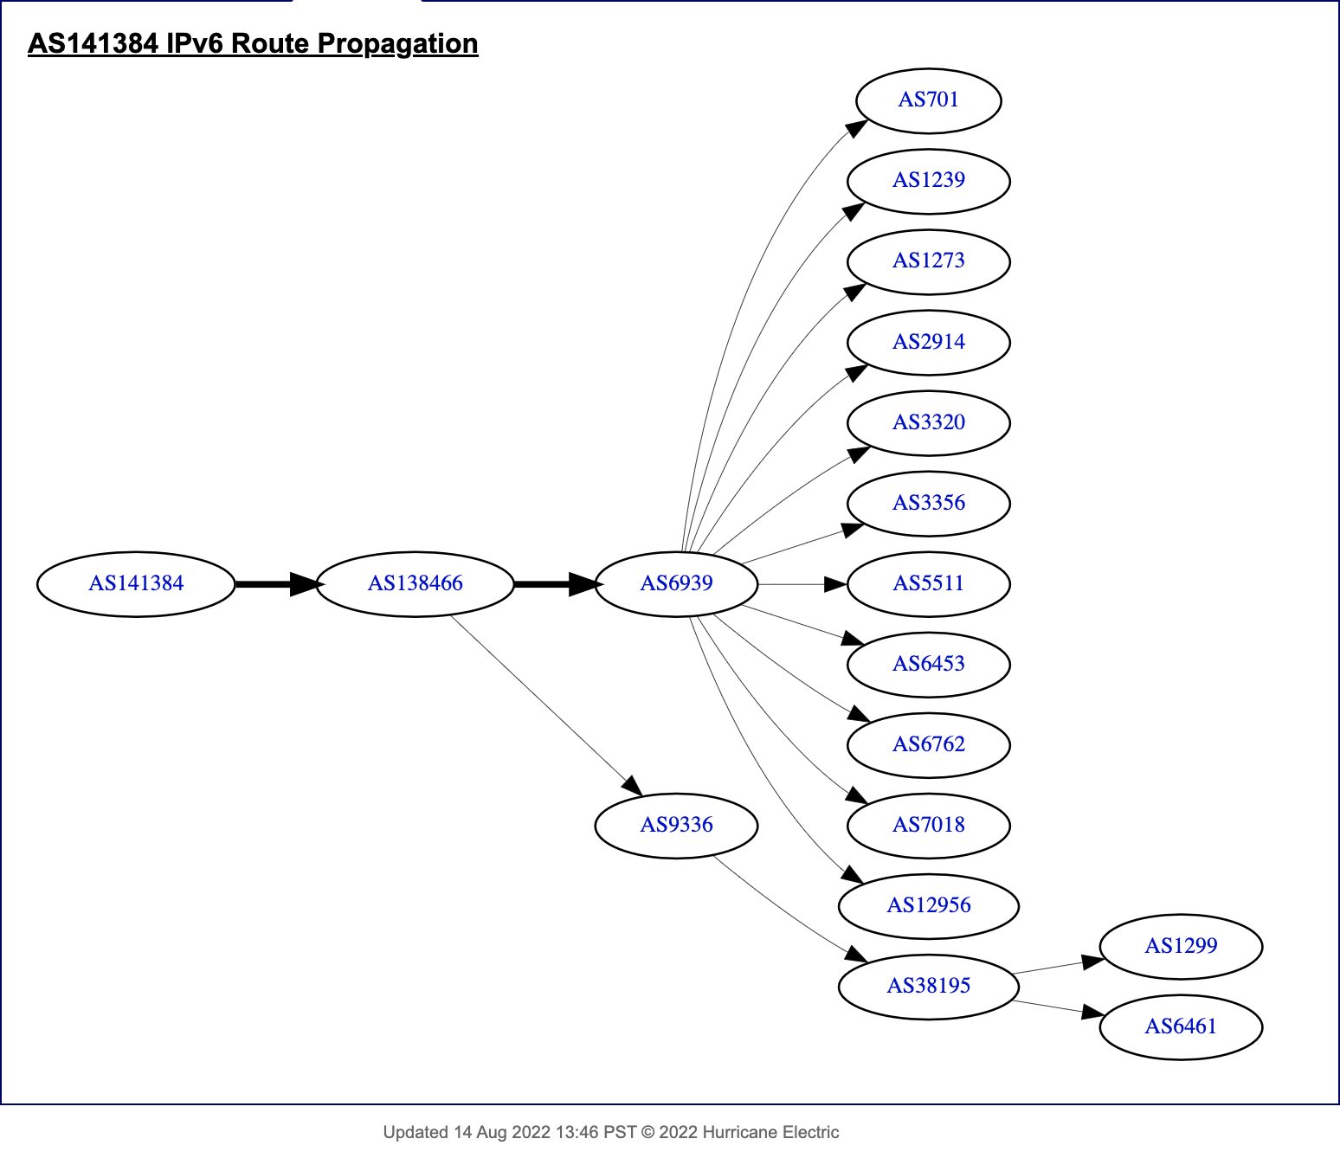
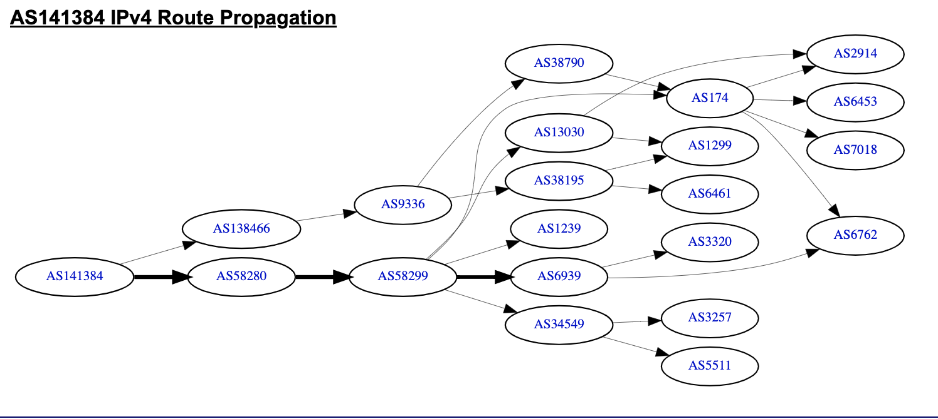
ISOC - Network Connectivity

Slide 5
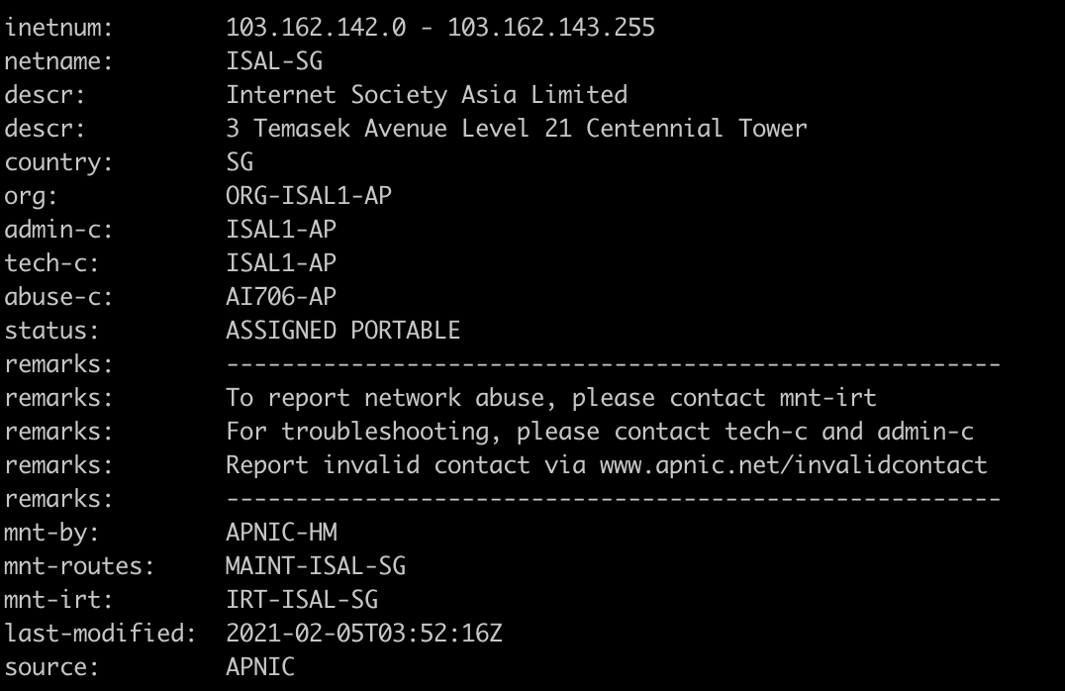
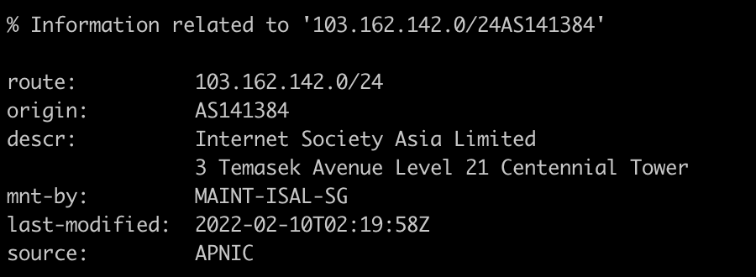
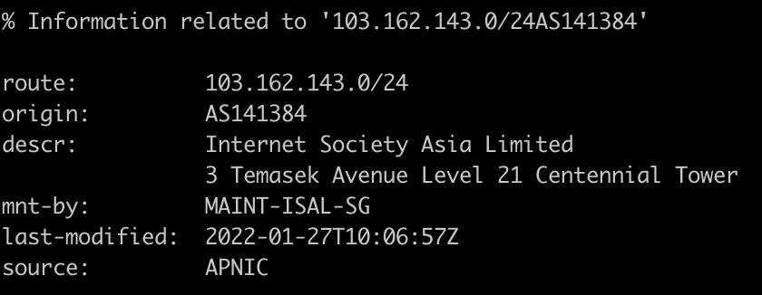
ISOC - Network Resources – Route Objects

Slide 6
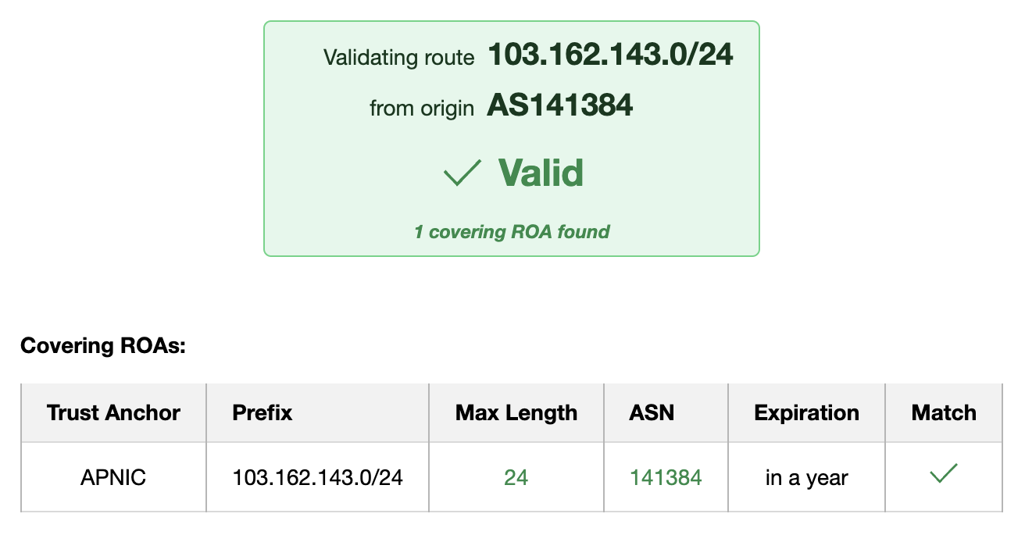
ISOC - Network Resources - ROA

Slide 7
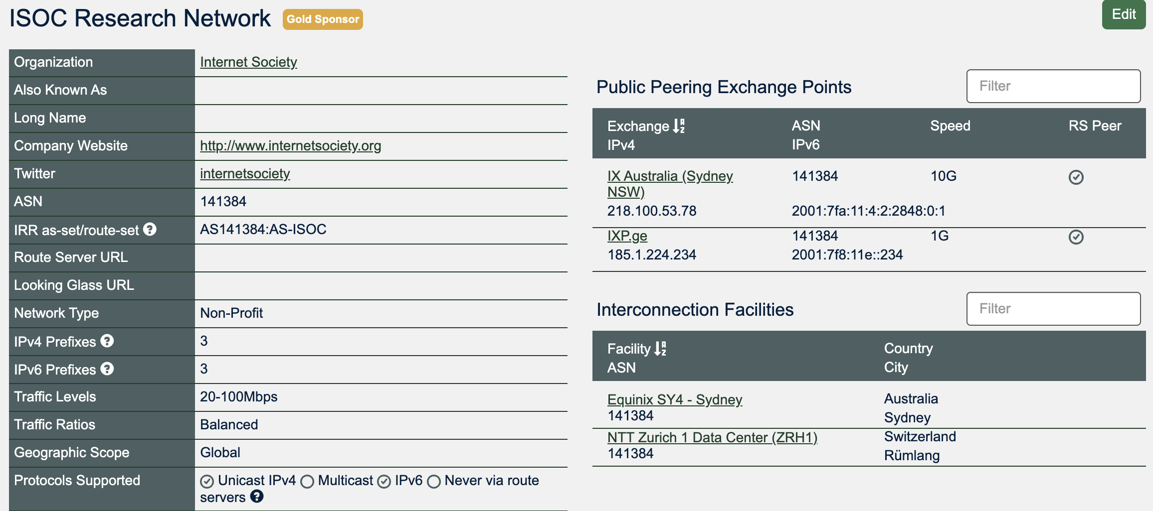
PeeringDB

Slide 8
The Problem
Network operators must publicly document their intended routing announcements in the appropriate RIR routing registry or create ROAs. This includes ASNs and IP prefixes originating on their own networks, as well as the networks for which they provide transit services.
Let’s see how GCC Region networks perform for RPKI?
Help me, help you!

Slide 9
RPKI – Easy Solution
Step 1: Create ROAs of all your “advertised” routes
Step 2: Enable ROV

Slide 10
Gulf Cooperation Council (GCC)
Country | Routed ASN | IPv4 Prefixes | IPv6 Prefixes
Bahrain (BH) | 20 | 1086 | 37
Kuwait (KW) | 70 | 2109 | 98
Oman (OM) | 19 | 984 | 204
Qatar (QA) | 13 | 380 | 385
Saudi Arabia (SA) | 142 | 9305 | 2817
United Arab Emirates (AE) | 82 | 4169 | 350
RIPE Stat Country Data

Slide 11
GCC – Routing Security Status (Sep 2022 – Sep 2023)

Slide 12
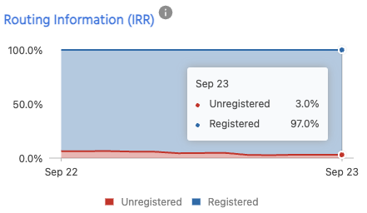
GCC – Routing Security Status (Sep 2022 – Sep 2023)

Slide 13
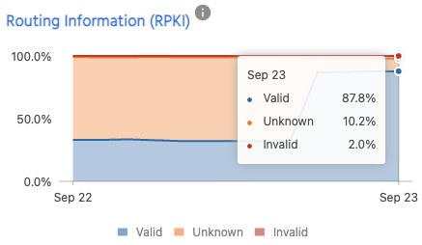
GCC – Routing Security Status (Sep 2022 – Sep 2023)

Slide 14
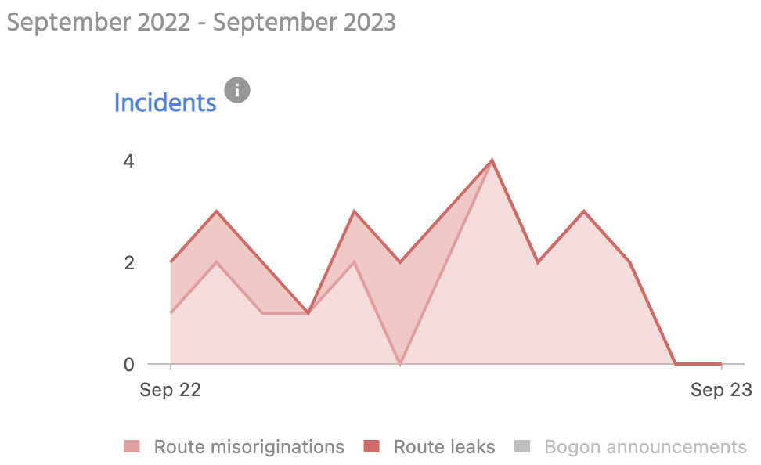
SA – Routing Security Status (Sep 2022 – Sep 2023)

Slide 15
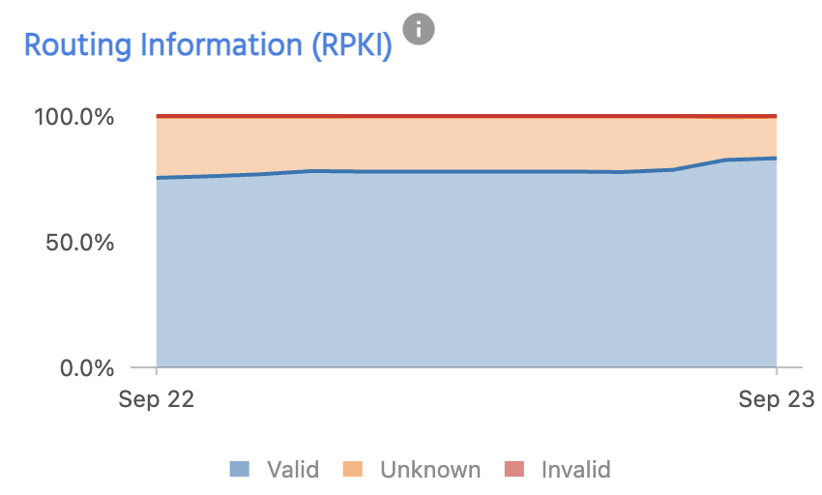
BH – Routing Security Status (Sep 2022 – Sep 2023)

Slide 16
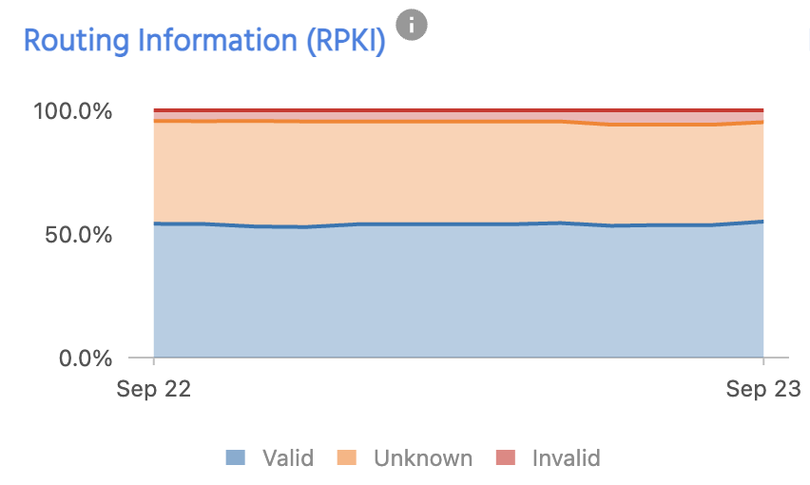
KW – Routing Security Status (Sep 2022 – Sep 2023)

Slide 17
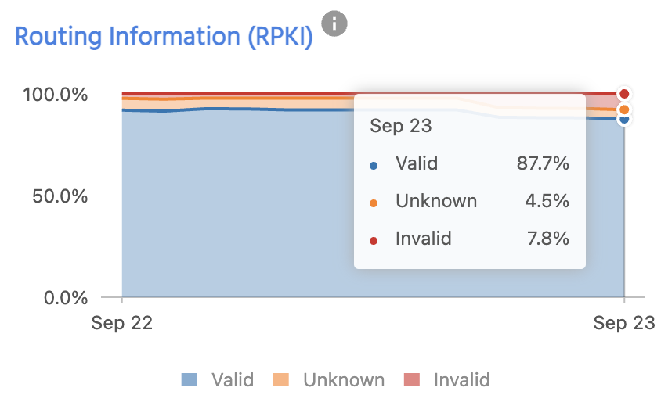
OM – Routing Security Status (Sep 2022 – Sep 2023)

Slide 18
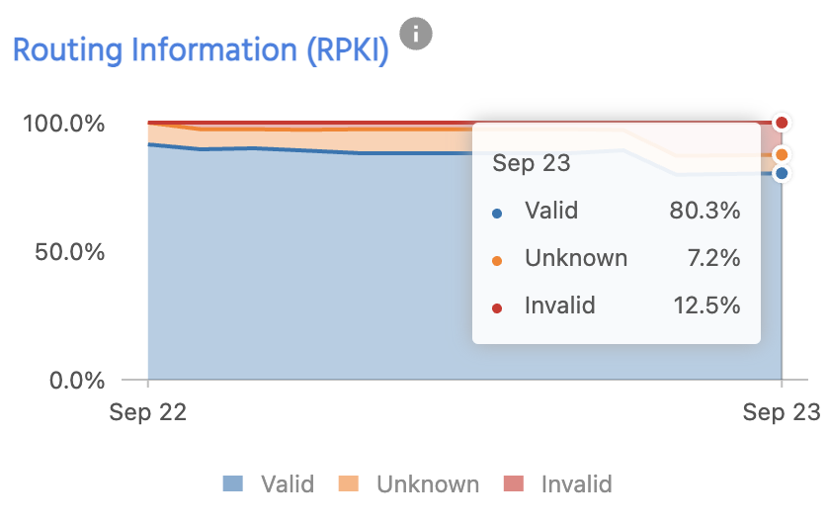
QA – Routing Security Status (Sep 2022 – Sep 2023)

Slide 19
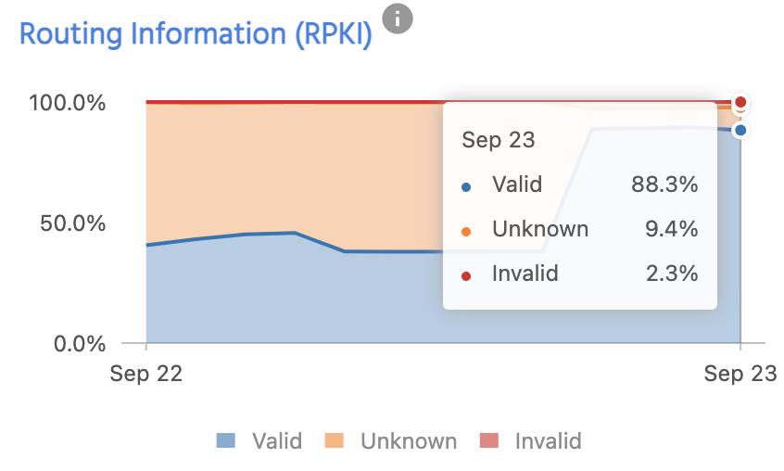
AE – Routing Security Status (Sep 2022 – Sep 2023)

Slide 20
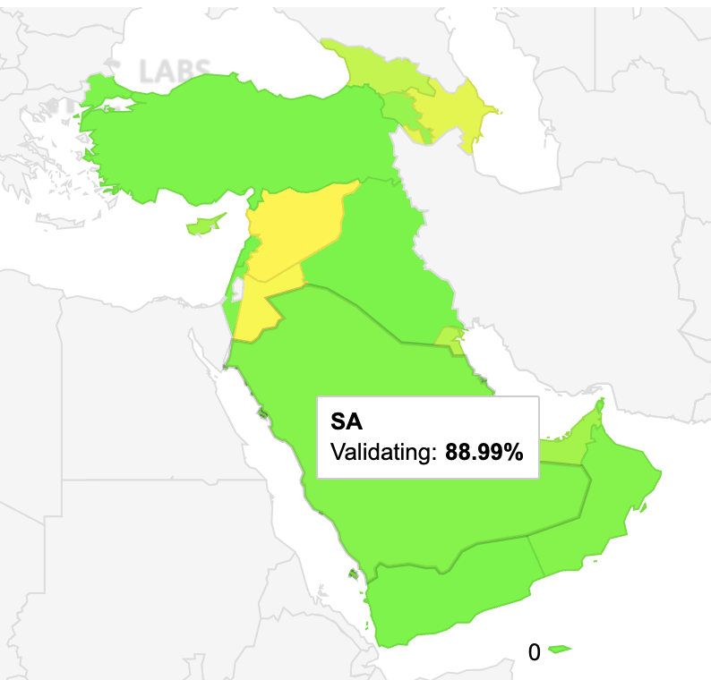
RPKI – No Duct Tape
Step 1: Enable ROA
GCC region is doing good in terms of Route Origin Authorisation
https://stats.labs.apnic.net/roa/SA

Slide 21
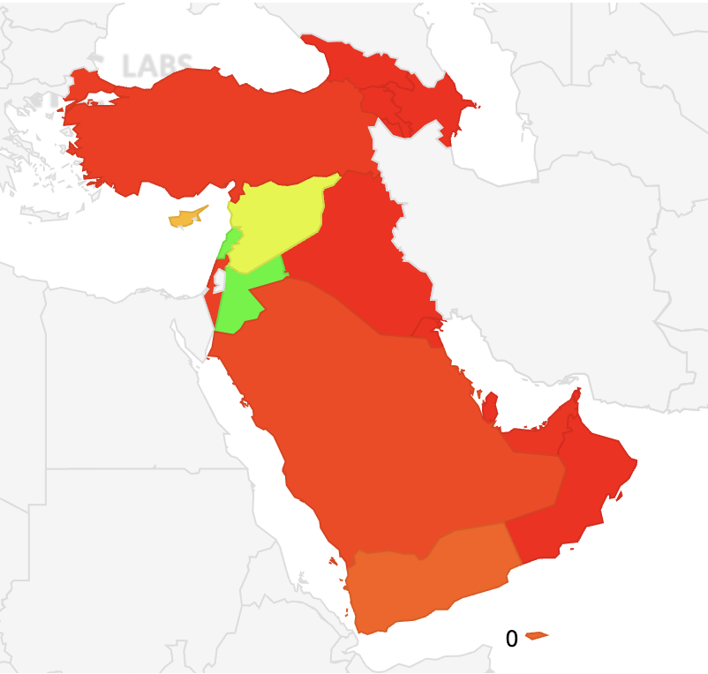
RPKI
Step 2: Enable ROV
GCC Region is ”Not” doing good in terms of Route Origin Validation
https://stats.labs.apnic.net/rpki/SA

Slide 22
So, What is the Solution?
Don’t rely on 3rd party IRR databases such as RADb, ALTDB etc, only use IRR services by RIRs .
ROA uptake is very good in GCC Region and can easily replace IRR.
If someone has created route object for your resources, then contact IRR operator.
Encourage operators to use RPKI (create ROAs – drop invalids).
Start implementing Route Origin Validation (ROV).
Will you be interested in getting monthly reports of your resources?
Sign up for MANRS (manrs.org)

